Slide 1

Toronto/Yorkville Rental Market
55C - October 5, 2019

Slide 2
Toronto CMA
Demographics

Slide 3

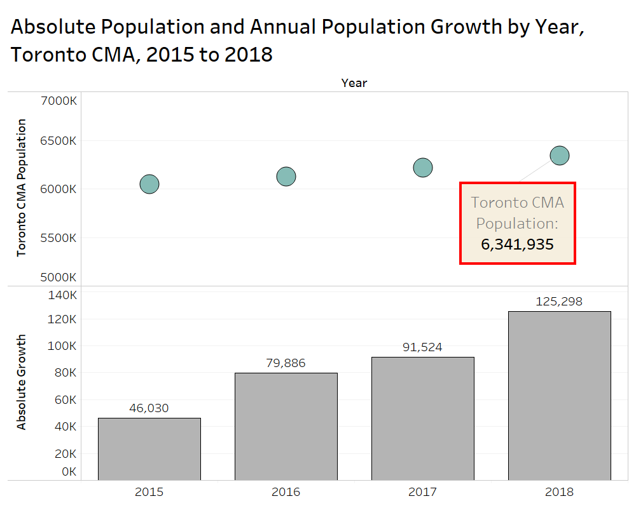
Toronto CMA Population Grew by 125,000 People in 2018
Average growth was 80,000 from 2007 to 2017

Slide 4
Toronto/Yorkville New Condo Market

Slide 5
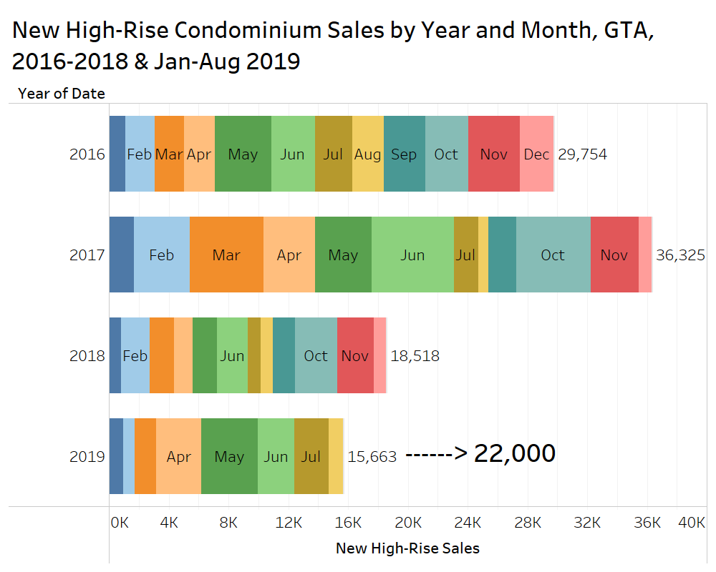
Toronto New Condo Sales Trending Up in 2019, Sales Improved but well Below Long-Run Demand

Slide 6
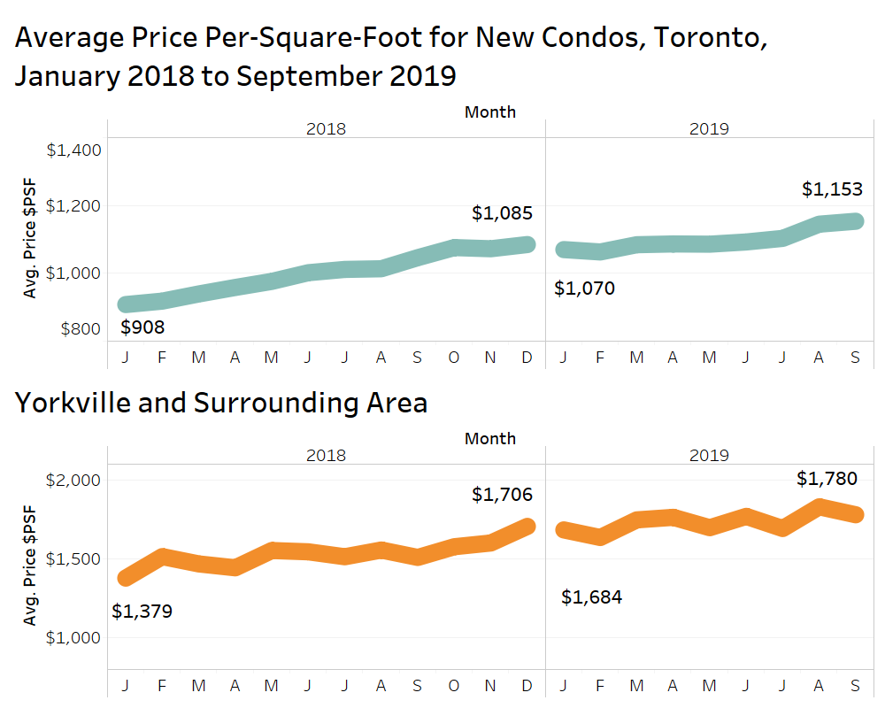
Toronto New Condo Prices up 10% Annually.
Yorkville Prices up 18% Annually.

Slide 7
GTA Condo Rental Market

Slide 8
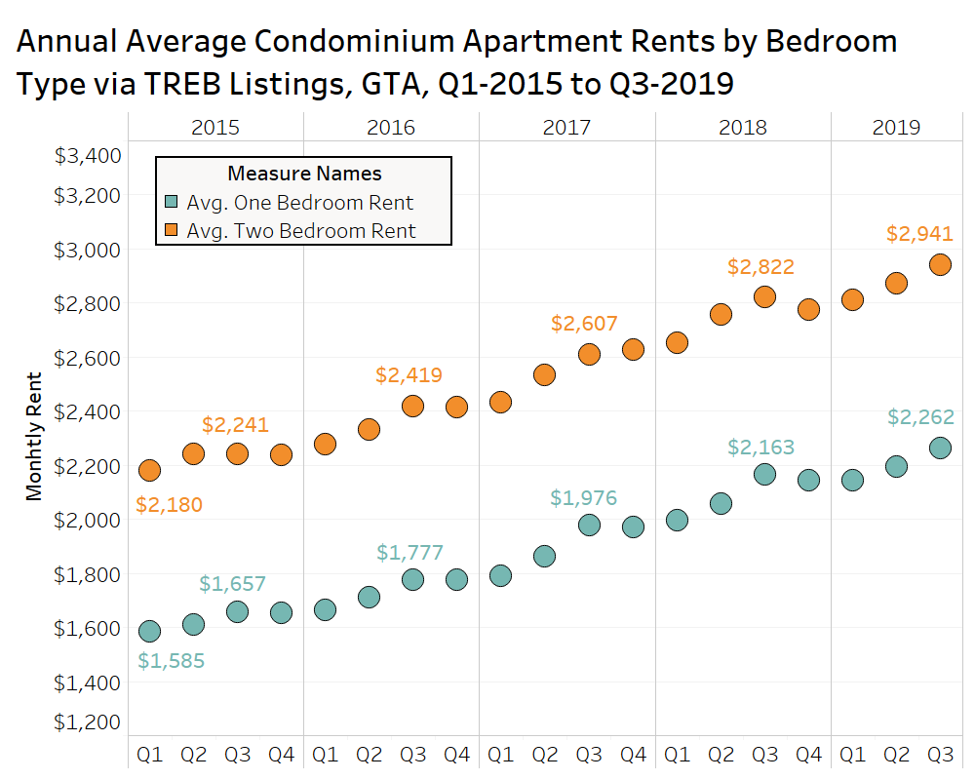

Condo Rental Rates up 5% Annually in the GTA
Growth was 10% in 2018
Stress Test, Rent Control, Interest Rate Hike, Rising Condo Prices & Population Spike are all Factors

Slide 9
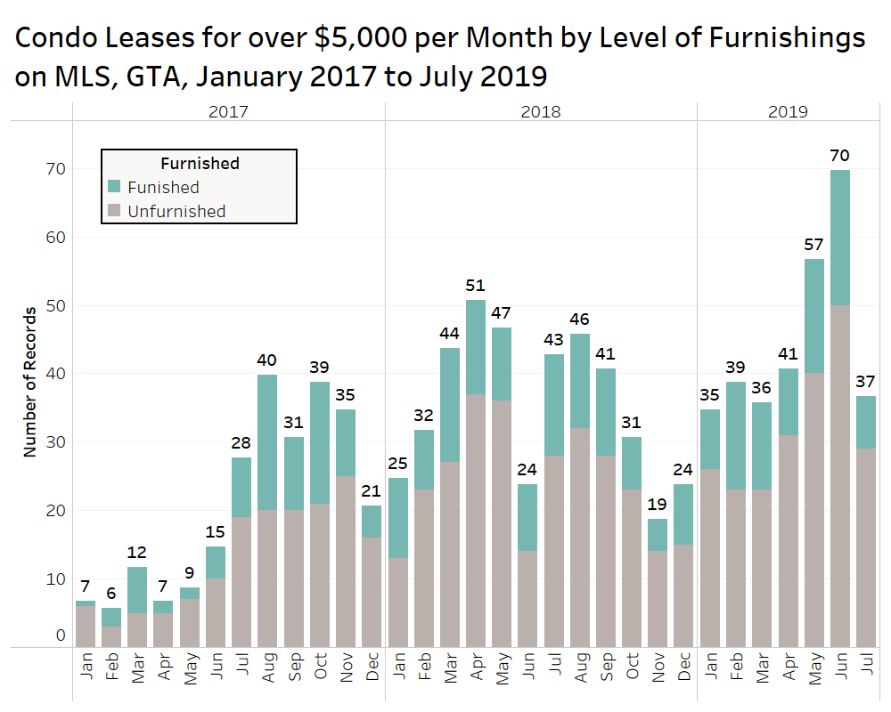
The Number of Condos Leased via MLS for Over $5,000 per Month in the GTA is Trending Upward.
127 Combined in May & June of 2019

Slide 10
Toronto/Yorkville Condo Rental Market

Slide 11
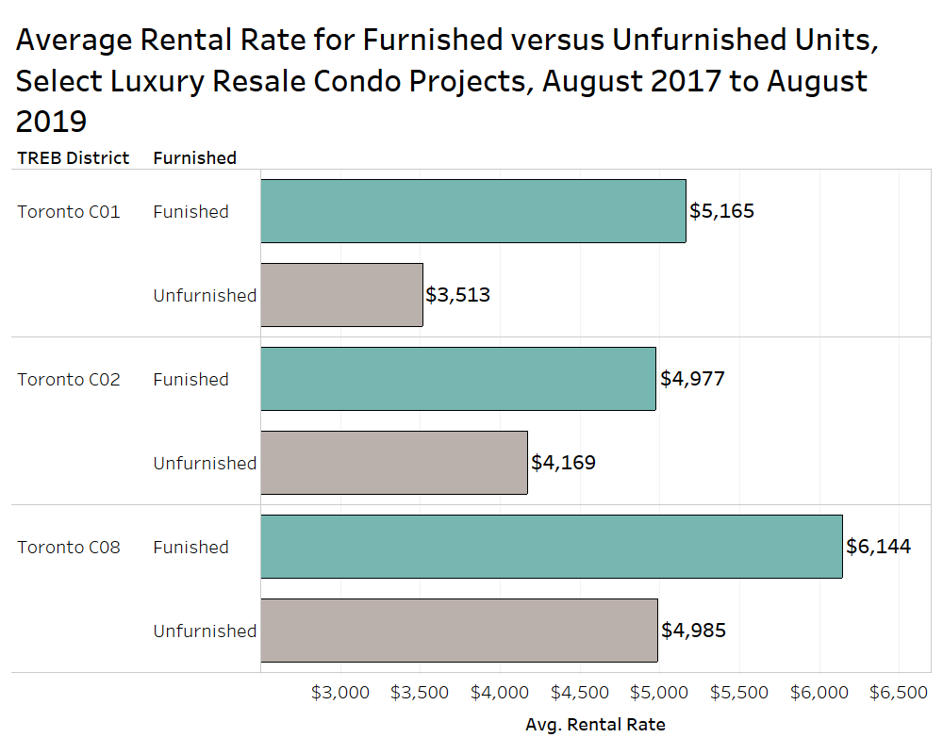
Furnished Units in Luxury Condo Projects in Toronto Leasing for a 30% Premium over Unfurnished Units

Slide 12
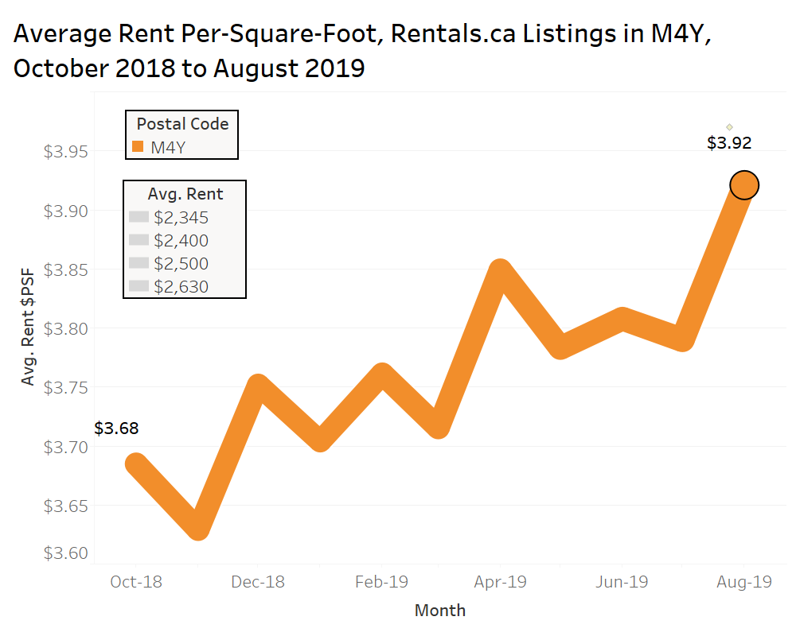
Average Condo Rental Rates in Postal Code M4Y up about 7% Annually

Slide 13
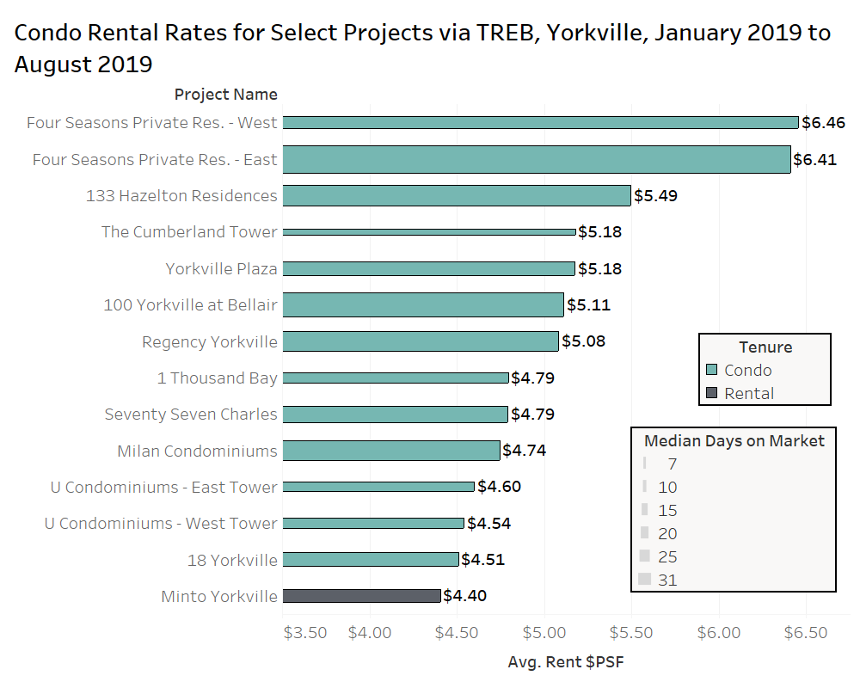
Four Seasons Leasing Suites for nearly $6.50 psf
Bay Street sites Getting $4.50 to $4.80 psf

Slide 14


Thank You
Ben Myers
President
Bullpen Consulting
Twitter: @Benmyers29
@BullpenConsult
BullpenConsulting.ca
Ben@BullpenConsulting.ca
Residential Real Estate Advisory Services – (416) 716 2096

Slide 15


Slide 16

MEET THE TEAM
CONNECT Investment Strategy
Working with a Winning Team
Why Toronto?
Why 55C and Yorkville?
A return on your investment
What’s next?

Slide 17
Toronto Real Estate vs TSX

Slide 18
Annual Returns TREB VS TSX

Slide 19
KEY STRATEGIES
No Work – Money works for you
Leverage
Risk minimization
Return Maximization
Deal types

Slide 20
WEALTH MULTIPLIER PORTFOLIO IN YEAR 25
Initial investment: $103,000
Portfolio value: $4,369,203
Equity value: $3,785,819
6 condos
Total income Annual income: $171,000
Total return: 3,675%
Annualized return: 15.5%

Slide 21
WEALTH MULTIPLIER PORTFOLIO IN YEAR 25
Property #1
$450,000 Purchase Price
$90,000 Down
Property #2
$580,000 Purchase Price
$116,000 Down – Refinance Property # 1
Property #4
$770,000 Purchase Price
$154,000 Down – Refinance Property # 1
Property #5
$770,000 Purchase Price
$154,000 Down – Refinance Property # 2
Property #3
$580,000 Purchase Price
$116,000 Down
Property #6
$770,000 Purchase Price
$77,000 Down – Refinance Property # 3
YEAR 1
YEAR 6
YEAR 12
Year 1
Portfolio $450,000
Equity $90,000
Year 25
Portfolio $8,738,406
Equity $7,571,638
Year 12
Portfolio $4,635,364
Year 6
Portfolio $1,734,000

Slide 22
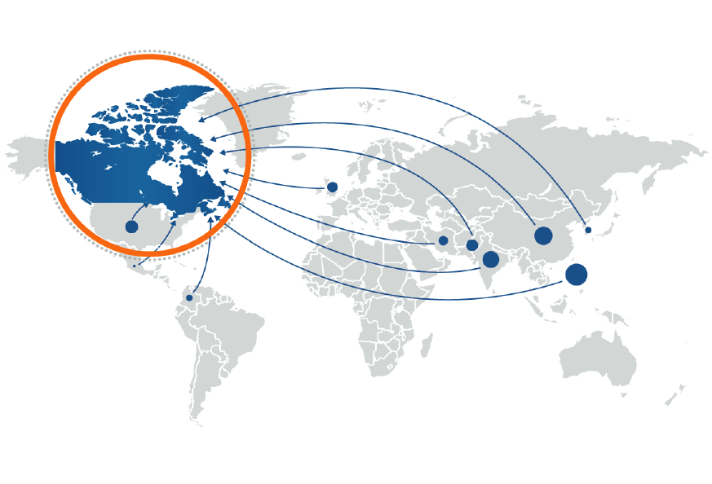
CANADA’S POPULATION GROWTH
__________________________________________________________________________
Source: Statistics Canada

Slide 23
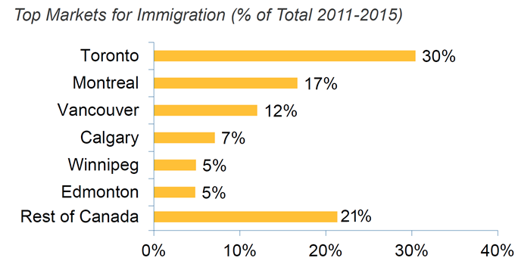
TORONTO’S POPULATION GROWTH
Approx. 201,000 newcomers to Toronto over the next two years.
Source: Statistics Canada

Slide 24
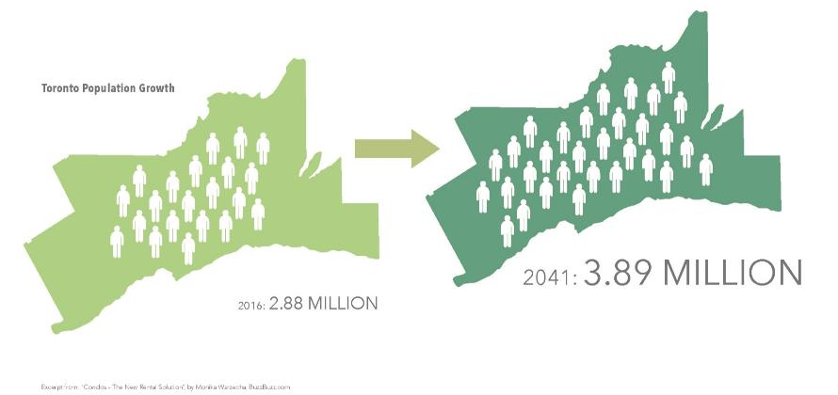
TORONTO’S POPULATION GROWTH

Slide 25
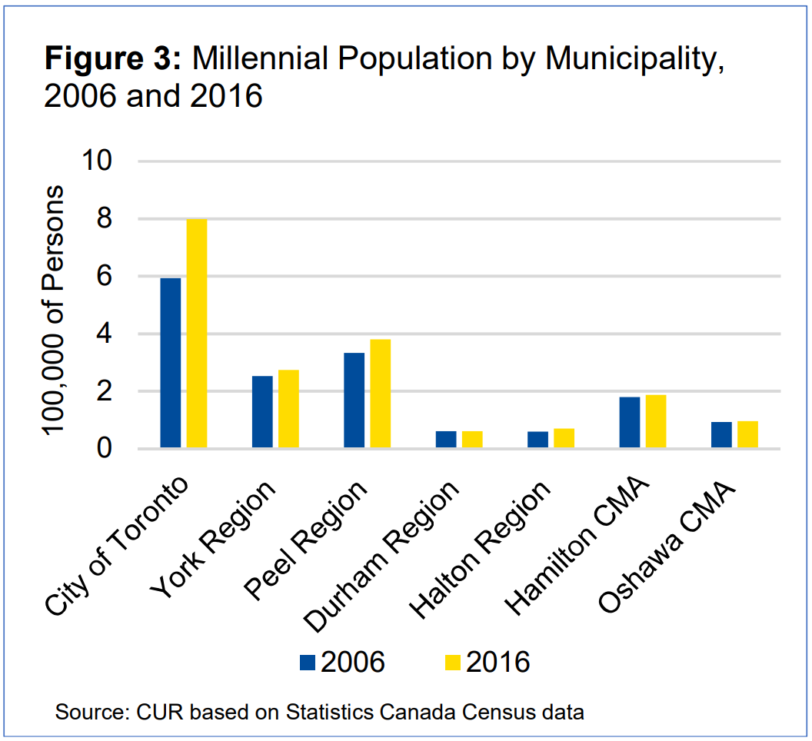
SUPPLY CAN’T KEEP UP WITH
THE NEXT GENERATION OF DEMAND
2018 Ryerson University’s Centre for Urban Research (CUR) and Statistics Canada study:
“There will potentially be almost 700,000 Millennials looking to break off into their own household in the next decade.”
“This pent-up demand will create almost 500,000 new Millennial-led households over the next decade, contributing strongly to net new household formation in the region.”
“Robust migration could attract a further 200,000 or more Millennials over the next decade.”

Slide 26
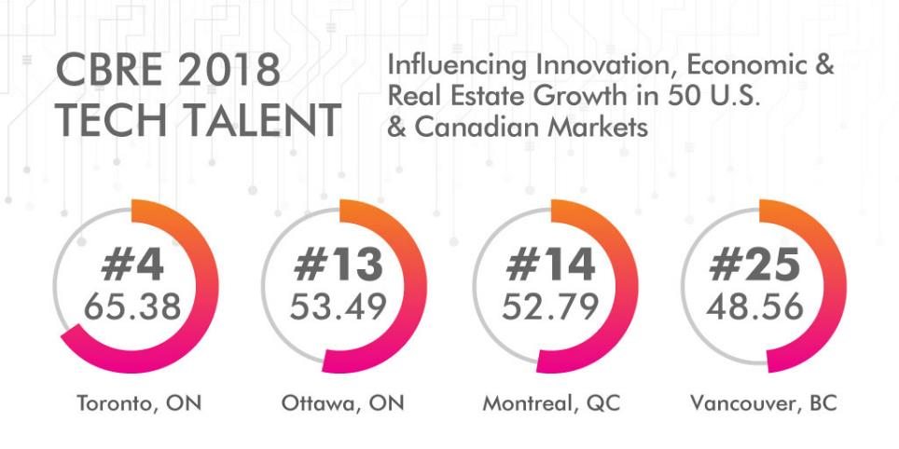
CBRE - BEST CITIES FOR TECH

Slide 27
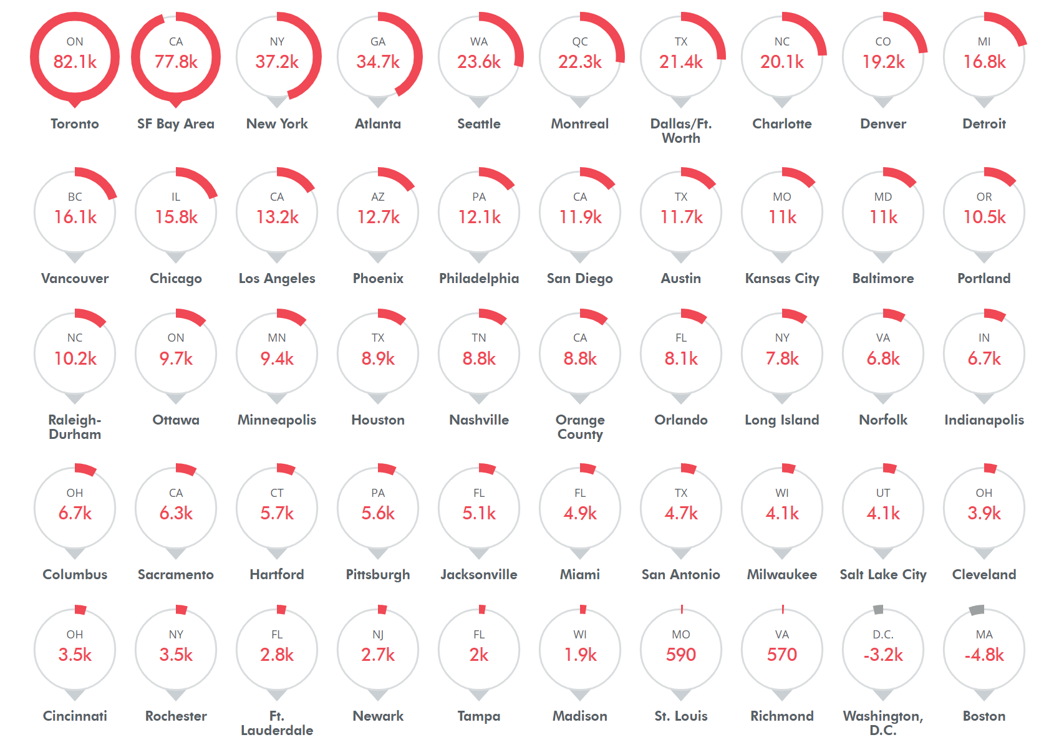
CBRE – FASTEST GROWING TECH MARKETS

Slide 28
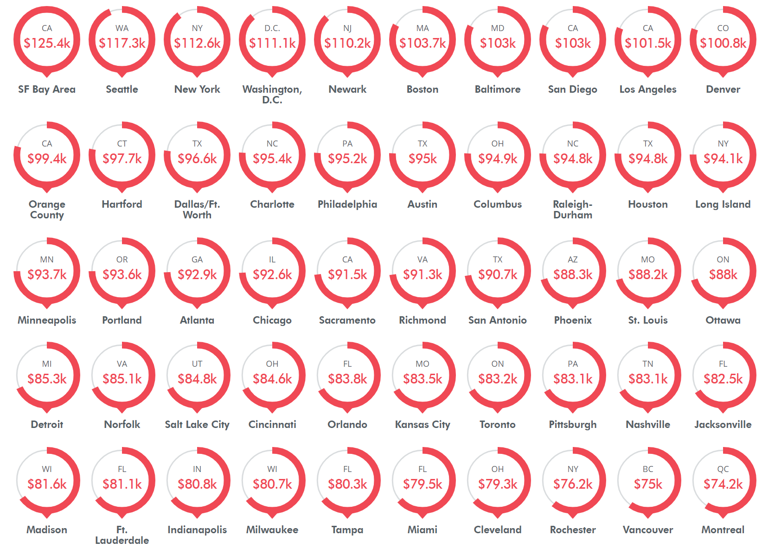
CBRE – MOST AFFORDABLE TECH MARKETS

Slide 29
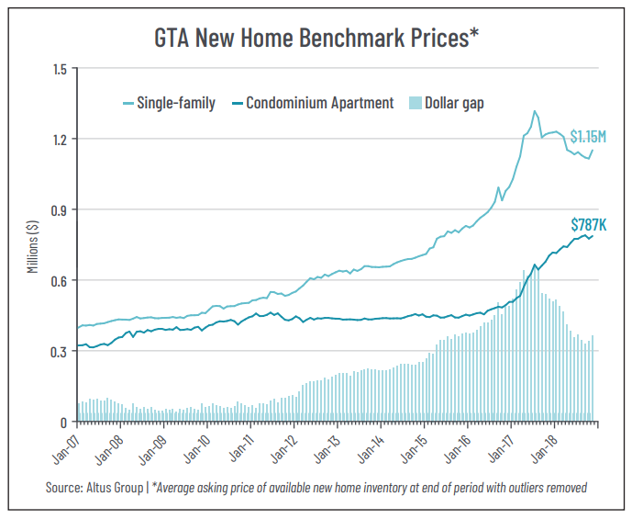
CONDOS: THE NEW AFFORDABILITY SOLUTION

Slide 30
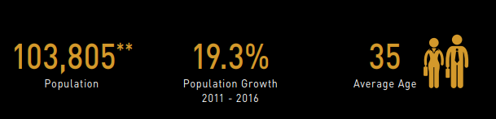
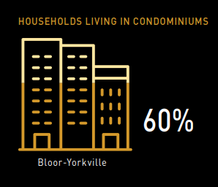

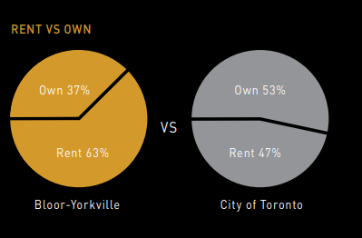
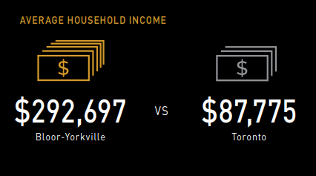
BLOOR-YORKVILLE VS TORONTO

Slide 31
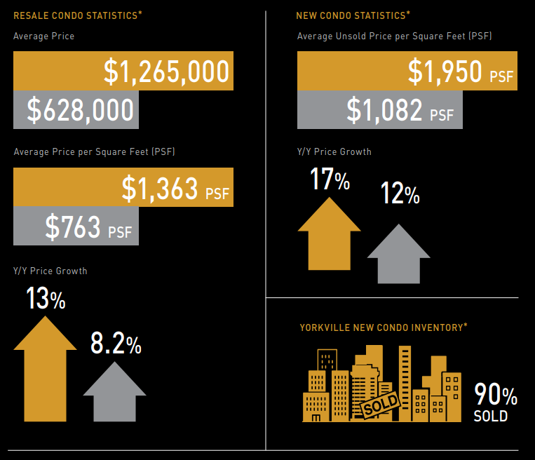
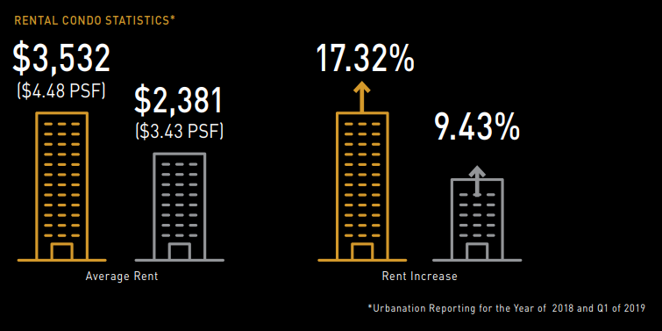
BLOOR-YORKVILLE VS TORONTO

Slide 32
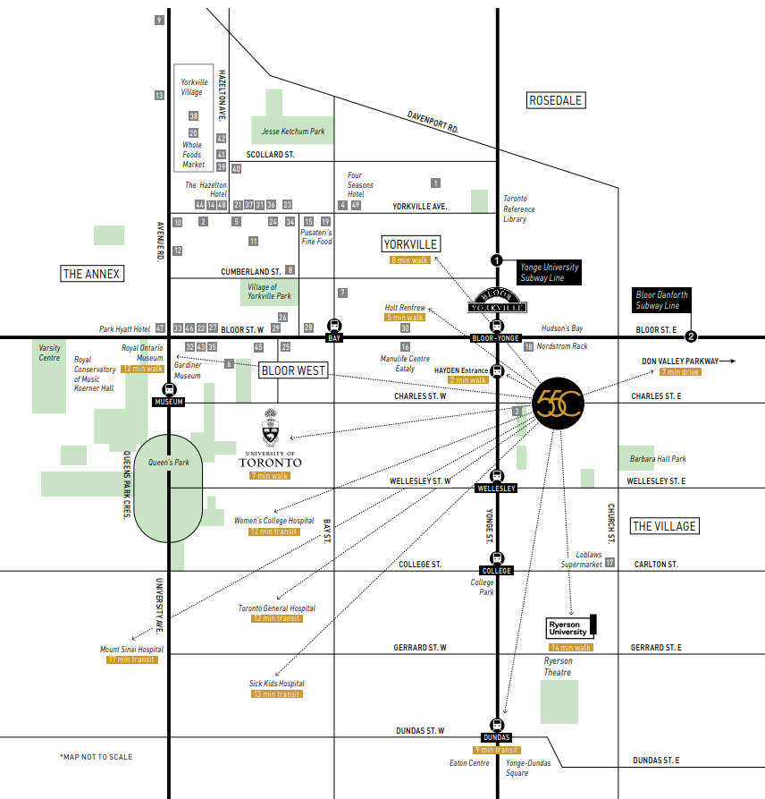
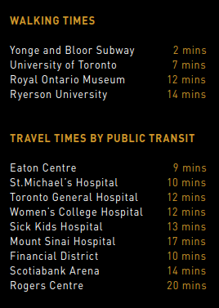
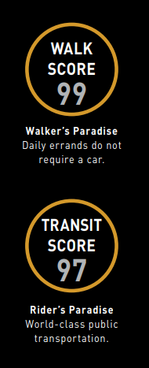
55C ACCESSIBILITY

Slide 33
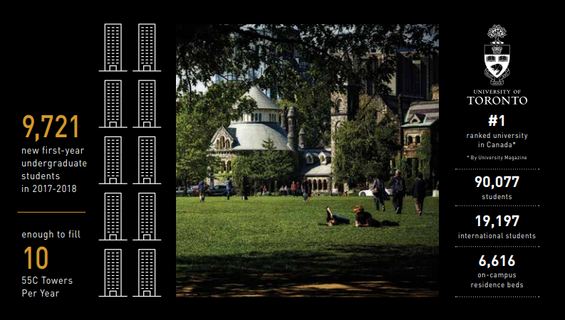
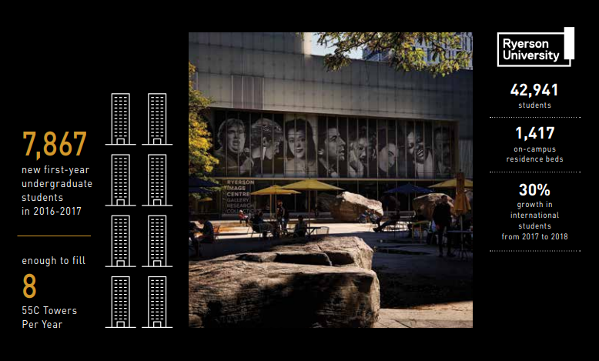
55C AND UNIVERSITY STUDENTS
55C is a 7 minute walk to the University of Toronto
55C is a 14 minute walk to Ryerson University
Latest student data from Immigration, Refugees and Citizenship Canada (IRCC)
As of December 31, 2018 there were 572,415 international students in Canada. That’s a 16.25% growth compared to last year, marking a third consecutive year of double-digit growth and an overall increase of 73% in the five years since 2014.

Slide 34



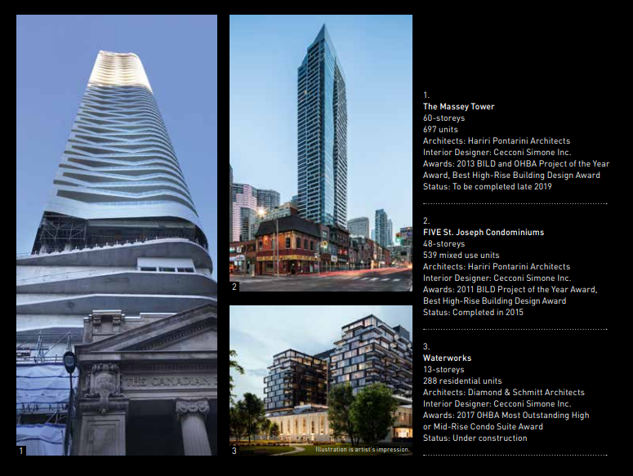

Slide 35
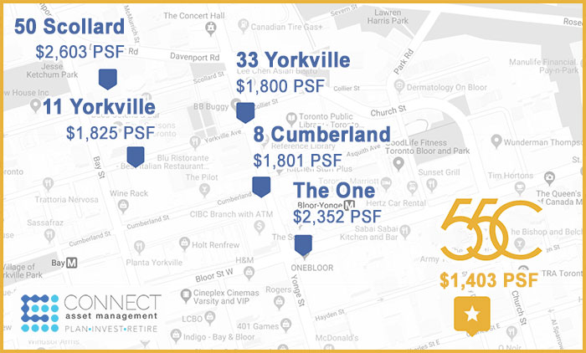
COMPARED TO OTHER YORKVILLE LUXURY CONDOS,
Source: 2019-Q2 from Urbanation
*11 Yorkville PSF is from current price list

Slide 36

MARCO TORONTO
Toronto’s leading property furnished rental company for more than 20 years
Specializes in short-term executive rentals for corporate, film and television, and sport companies
Offers Airbnb services
The 55C executive rental package (valued at over $30,000) consists of:
FREE furnishing and furniture
One year of FREE property management
WAIVED occupancy fees for the first two months

Slide 37
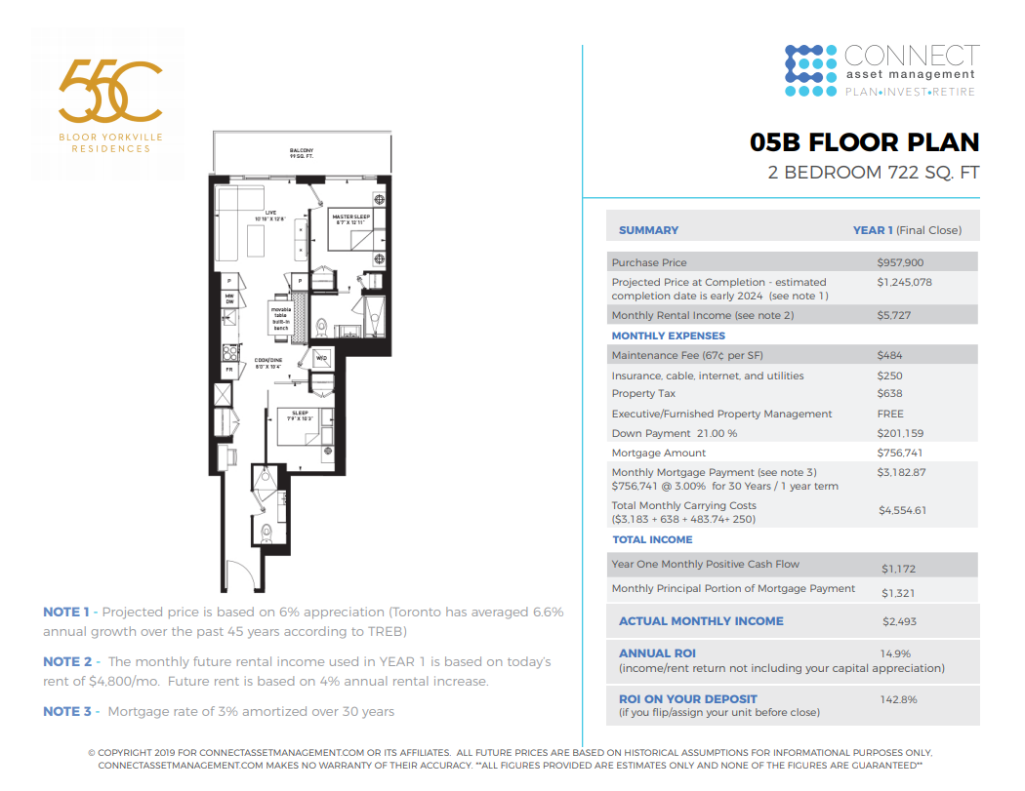

Slide 38
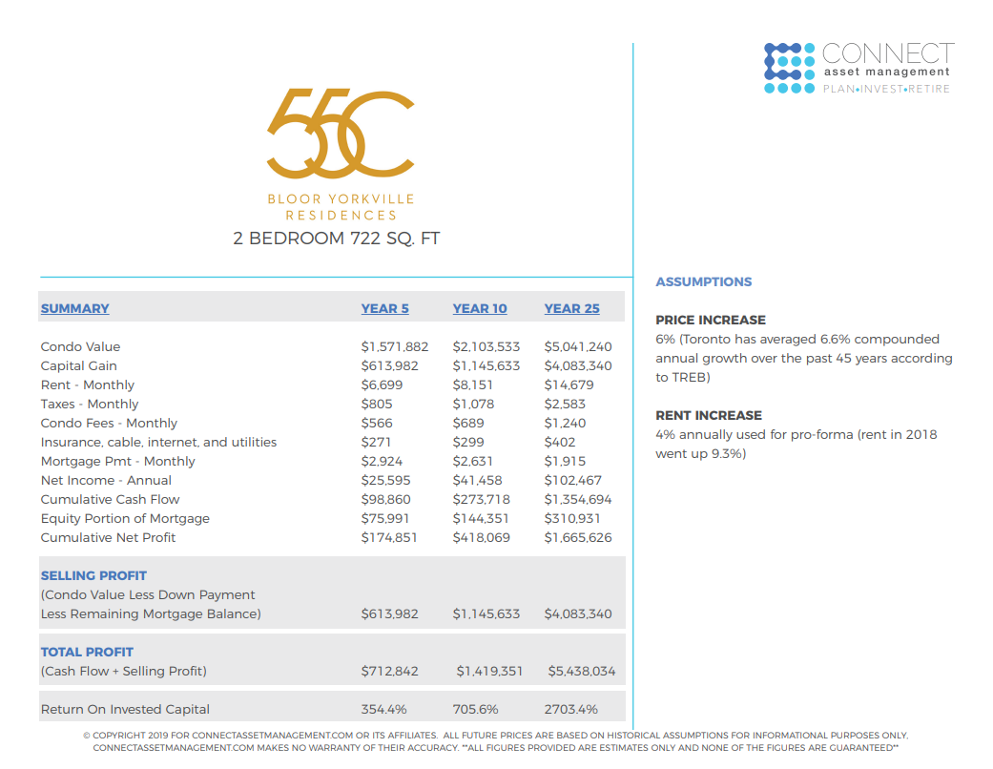

Slide 39
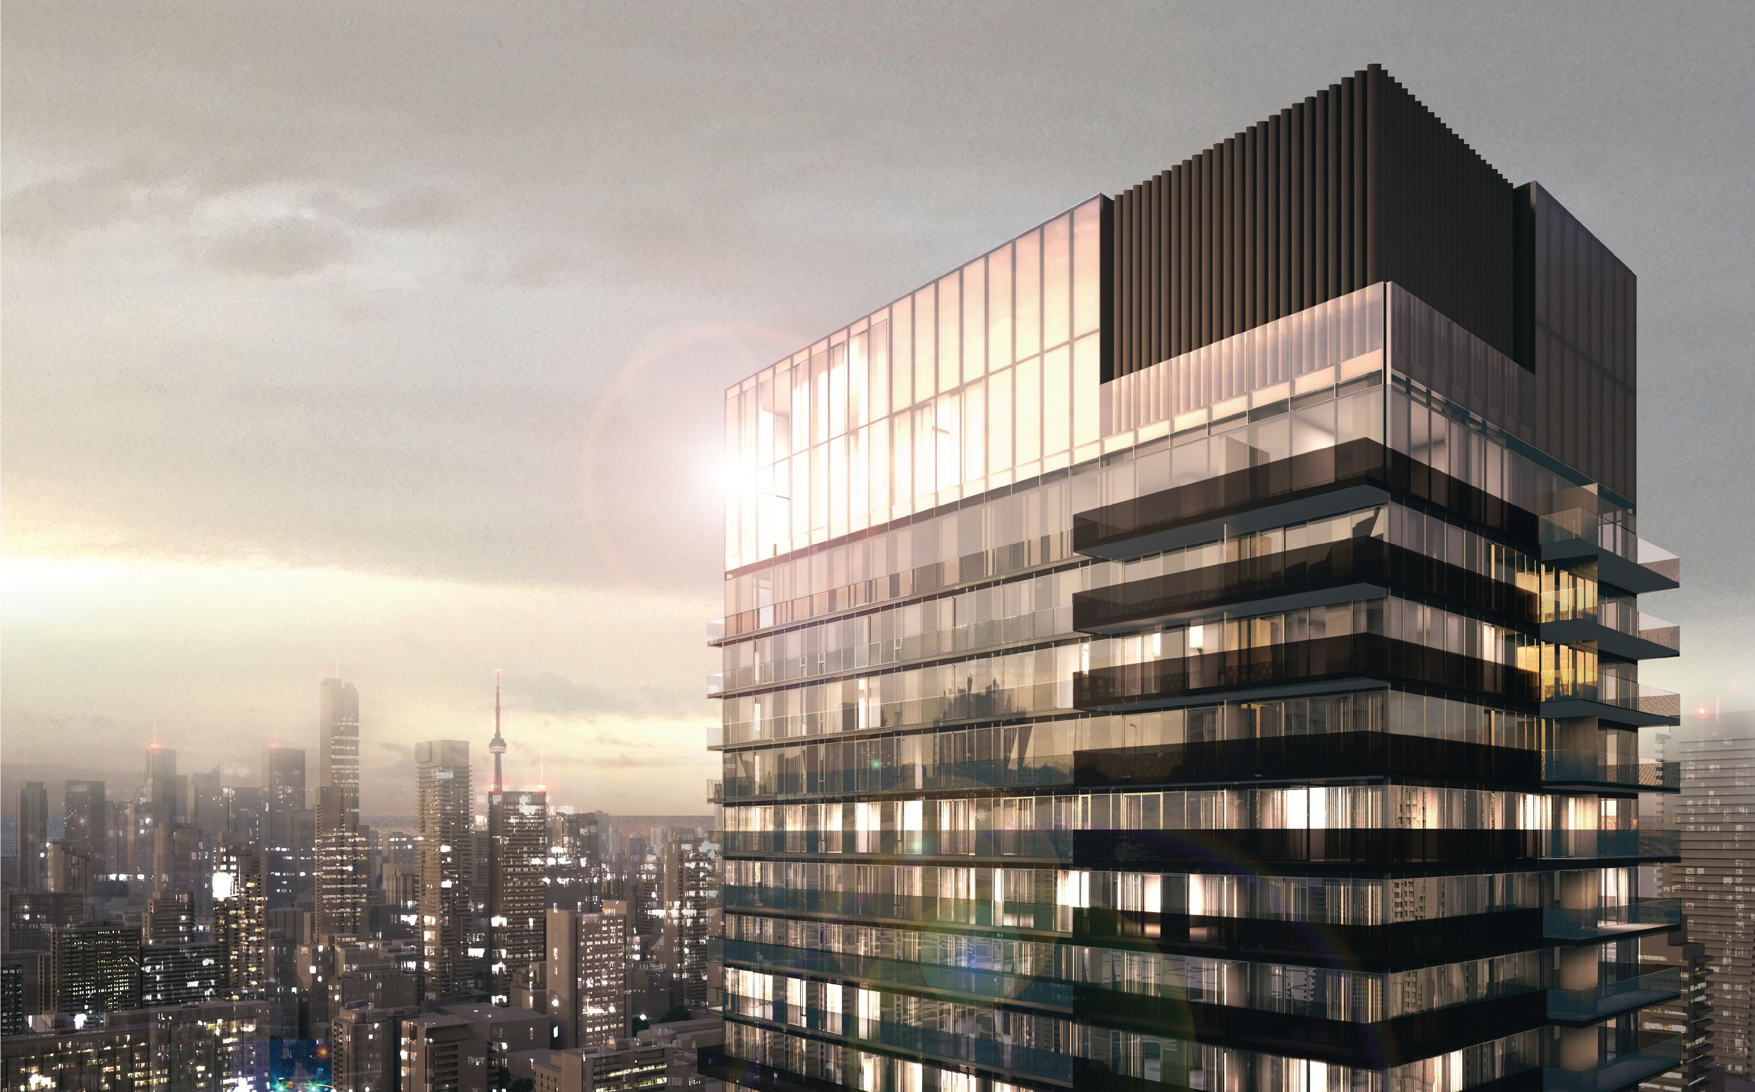
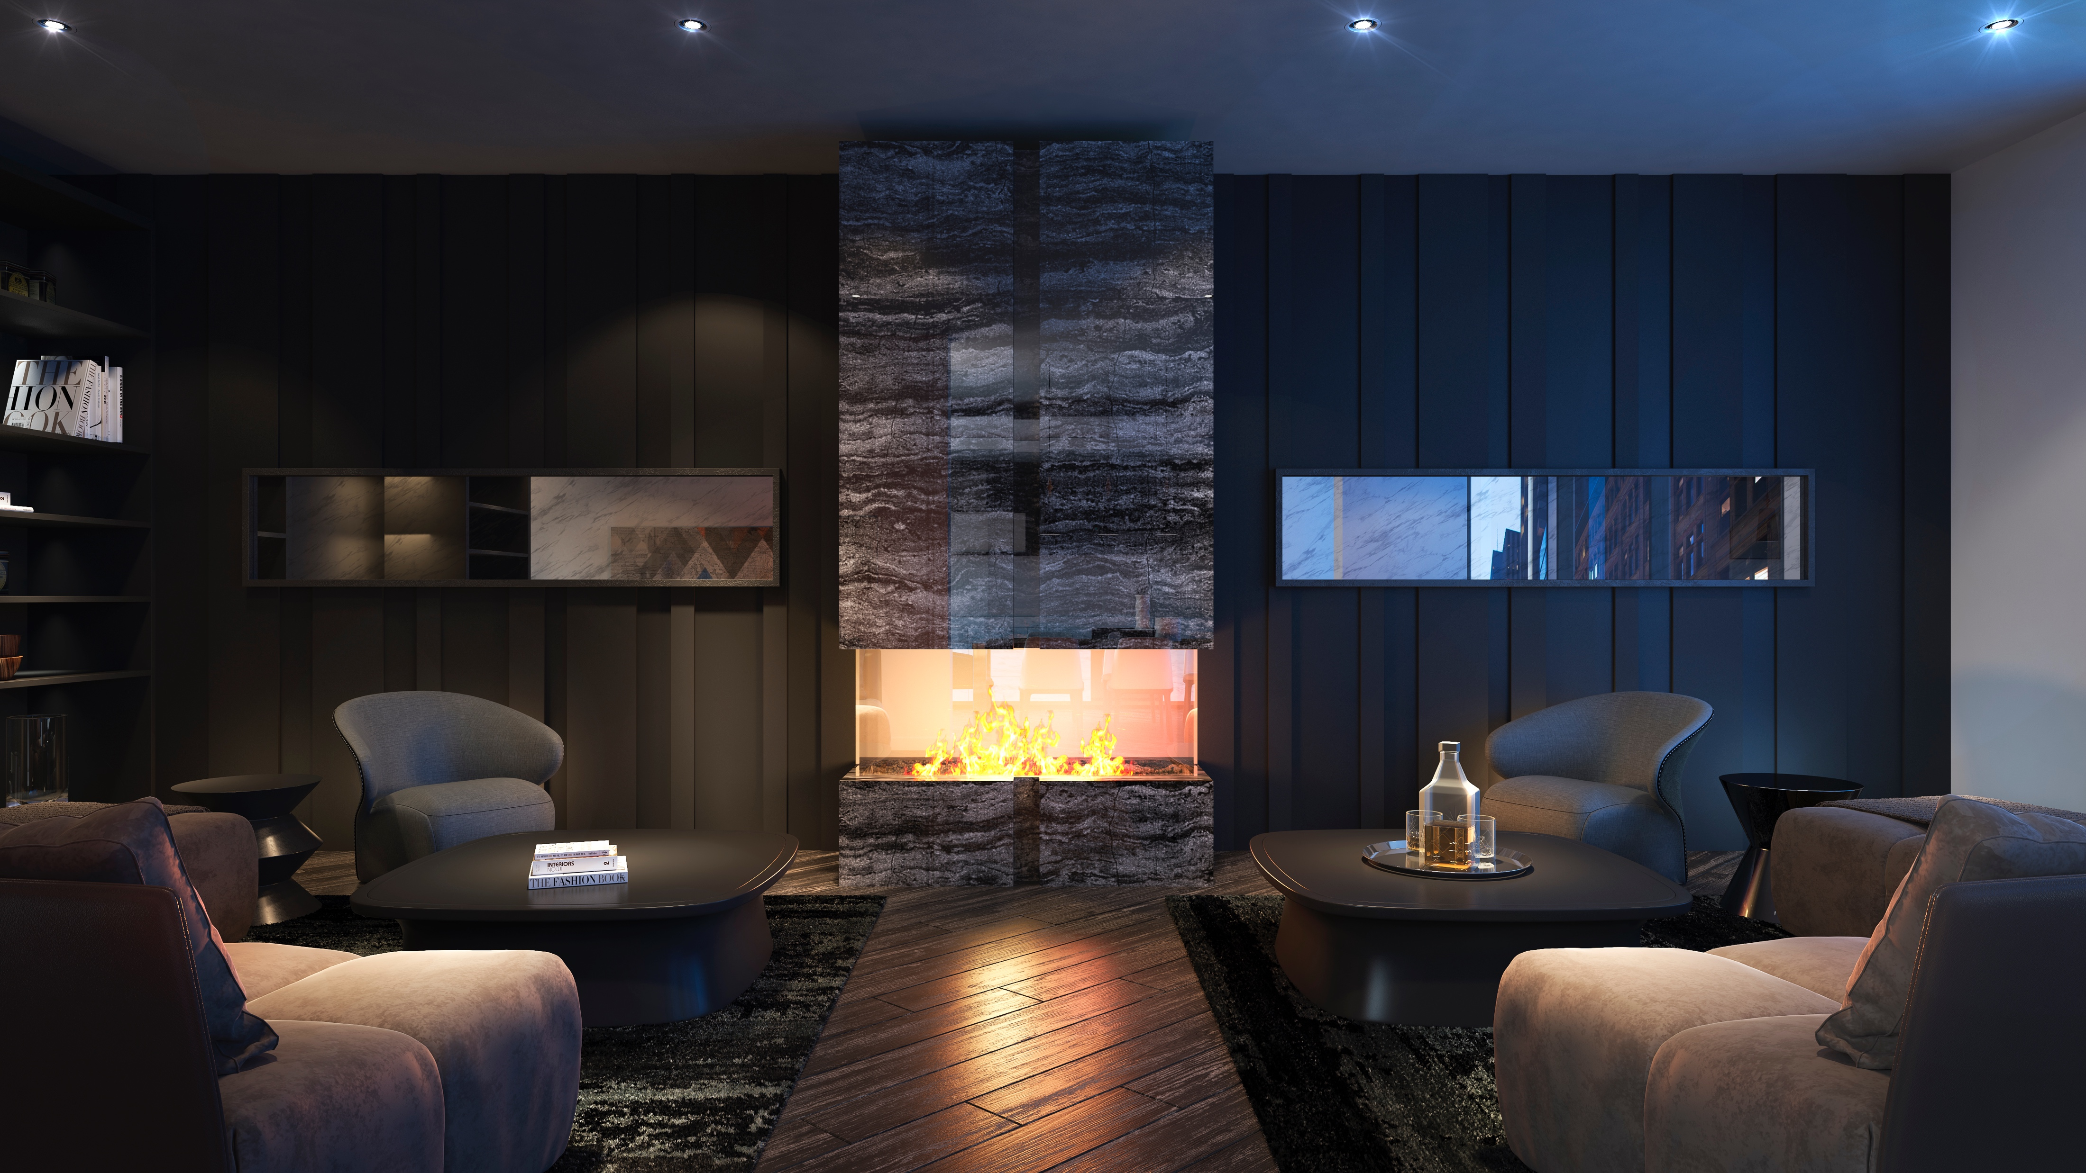
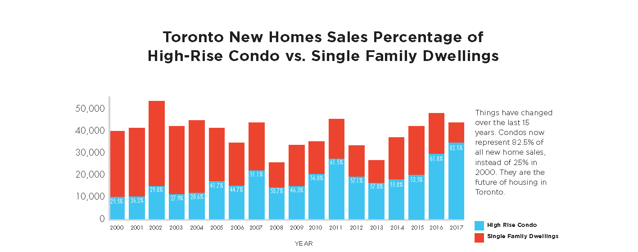


Slide 40
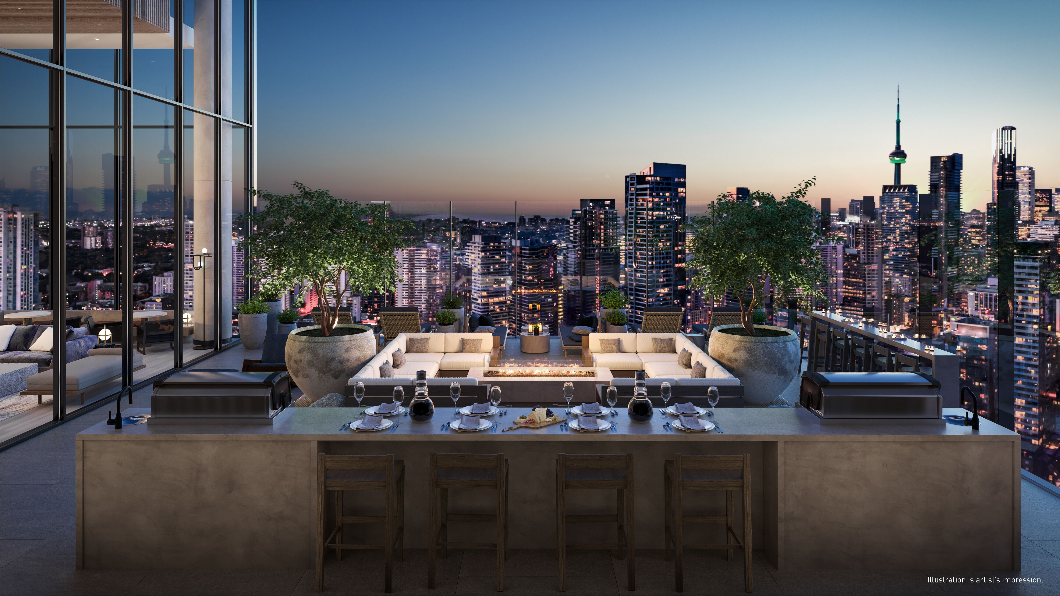

Slide 41
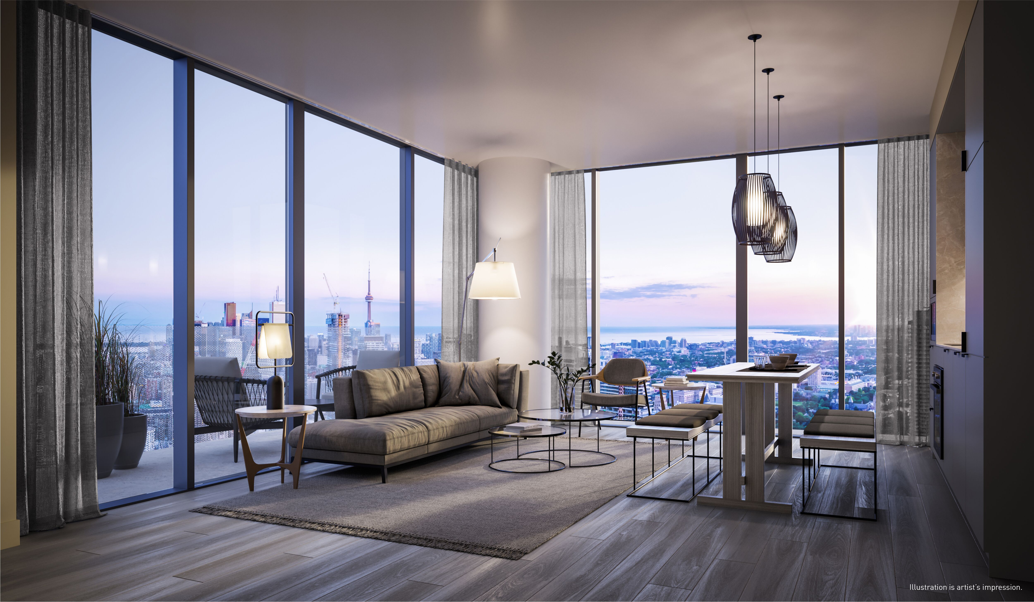

Slide 42
EXCLUSIVE INCENTIVES
$40,000-$60,000 in upgrades including furnishings
Free Assignment ($5000 value)
Right to lease during interim occupancy
Reduce parking and locker
Extended deposit structure
Capped Development Fees
1 year executive rental program
2 months free occupancy

Slide 43


WHAT HAPPENS NEXT?
WE ARE HERE TO HELP YOU
If you have any questions, please see Matt or Ryan
If you would like to fill in a worksheet, please see one of our reps that have a clipboard.
Please have your government issued photo ID ready.

