Slide 2
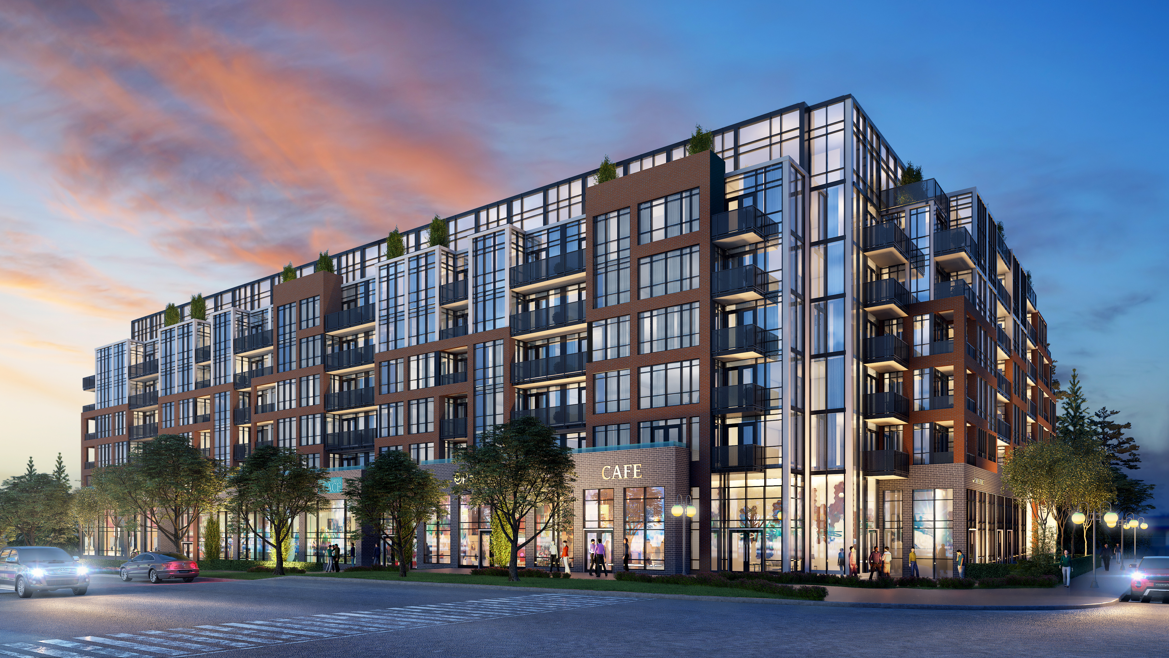
SOUTH DISTRICT CONDOS

Slide 3
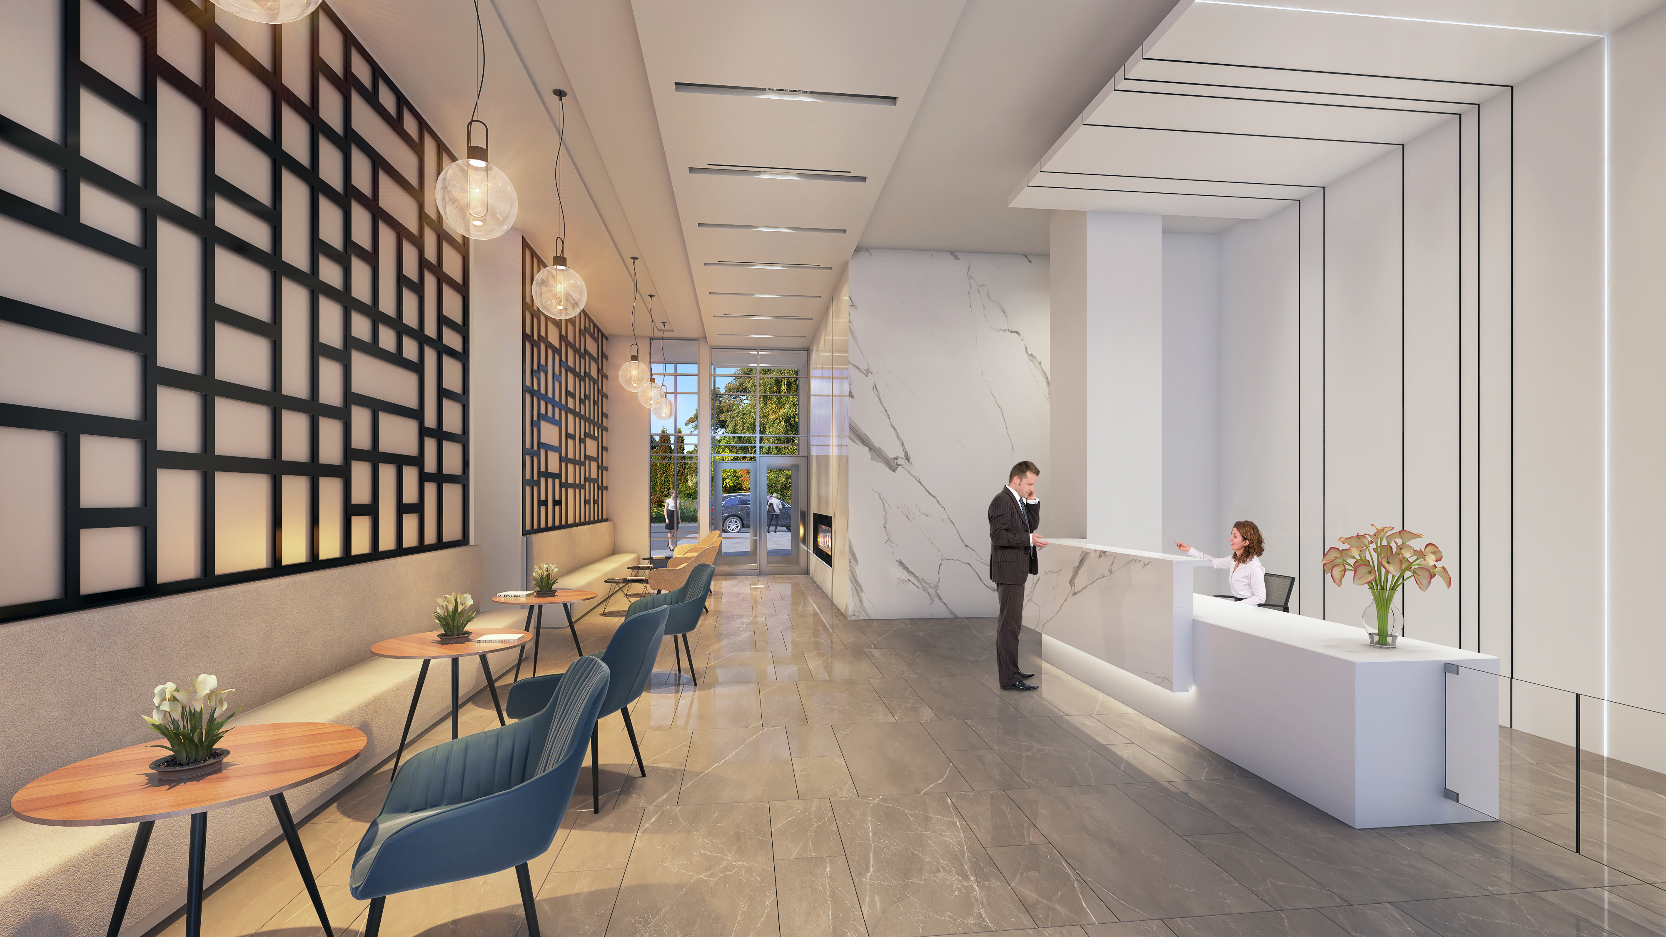
LOBBY

Slide 4
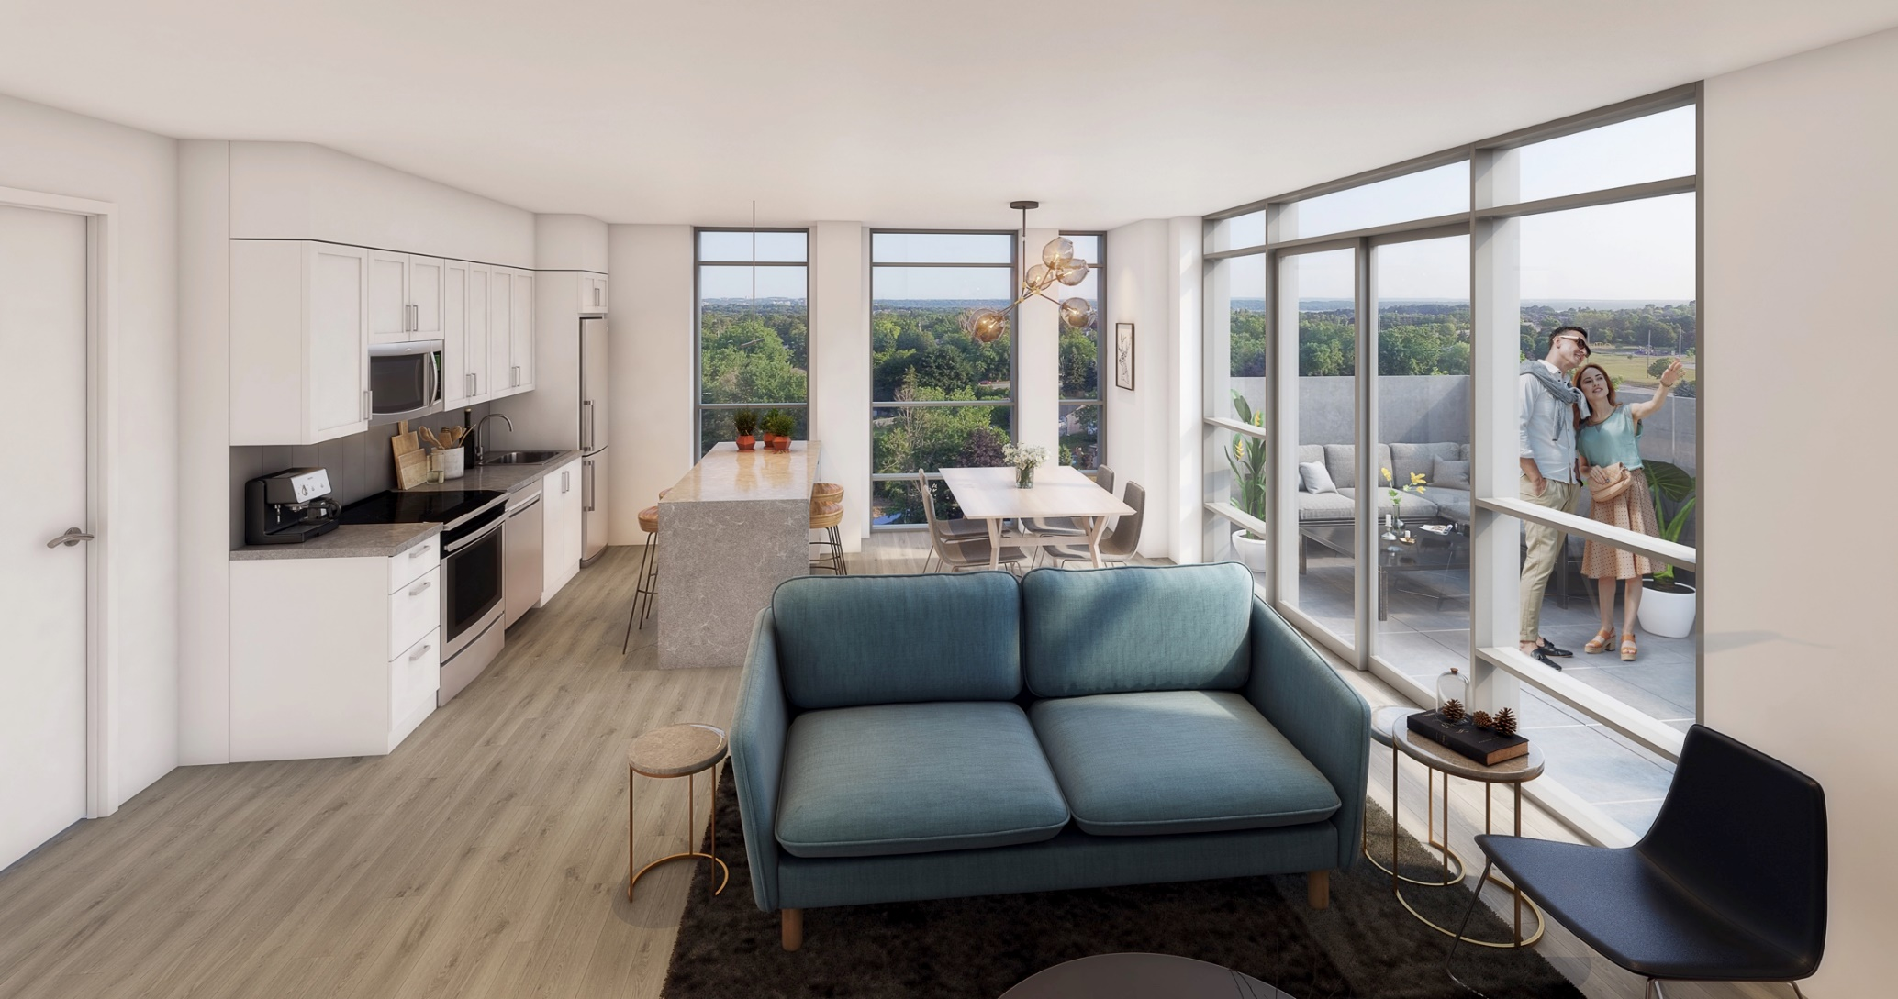
INTERIOR UNIT RENDERING

Slide 5
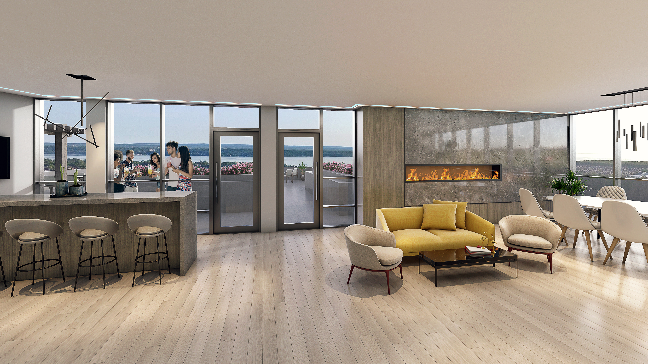
PARTY ROOM

Slide 6
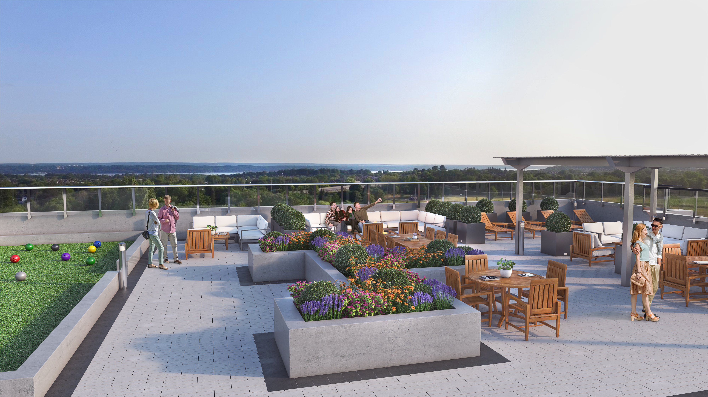
ROOFTOP PATIO

Slide 7
KEY POINTS

Slide 8
DEVELOPER: Queensgate Homes & Brixen Developmnet
ARCHITECT: Architecture Unfolded
NUMBER OF FLOORS: 7
NUMBER OF UNITS: 183
NUMBER OF SUITE MODELS: 57
BEDROOM SIZES: Ba, 1B, 1B+D, 2B, 2B+D
START OF CONSTRUCTION: January 2020
OCCUPANCY: Interim start February 2022

Slide 9
AMENITIES

Slide 10
FITNESS CENTER/YOGA STUDIO
ROOFTOP PATIO
PARTY ROOM
WORK SPACE
PART TIME CONCIERGE

Slide 11
SUITES & SIZES

Slide 12
Bachelor 400 sq.ft.
1 Bedroom 510 sq.ft to 655 sq.ft.
1 Bedroom + Den 685 sq.ft. to 735 sq.ft
2 Bedroom 760 sq.ft. to 1070 sq.ft.
2 Bedroom + Den 905 sq.ft. to 112O sq.ft.

Slide 13
PARKING AND LOCKERS

Slide 14
PARKING INCLUDED WITH:
1 B+DEN
2 B
2 B+DEN
PARKING PURCHASE:
1B SINGLE SPOT $15,000 (MAX. 1) AT TIME OF SALE
2B & 2B+D UPGRADE TO TANDEM $20,000 AT TIME OF SALE
WAITLIST:
BA (MAX. 1)
1B+D UPGRADE TO TANDEM
LOCKER: $6,000 (MAX. 1 PER SUITE) AT TIME OF SALE

Slide 15
GROUND FLOOR LAYOUT

Slide 16
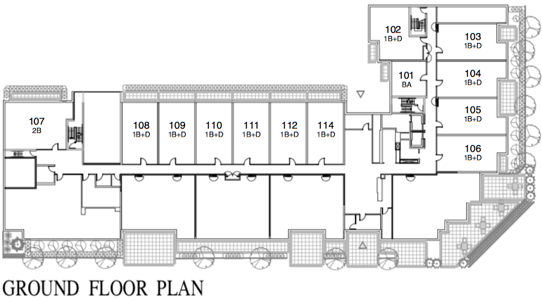

Slide 17
2ND FLOOR LAYOUT

Slide 18
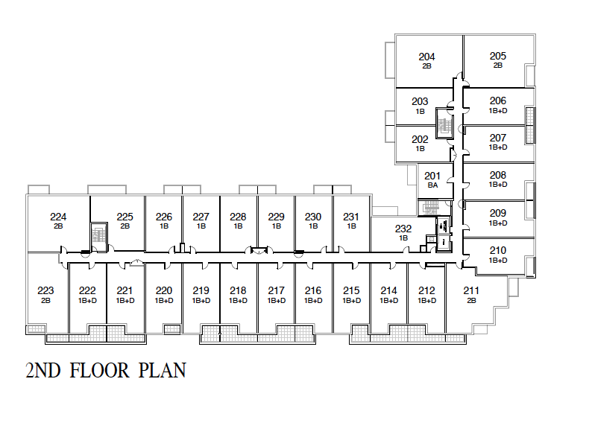

Slide 19
3RD TO 6TH FLOOR LAYOUTS

Slide 20
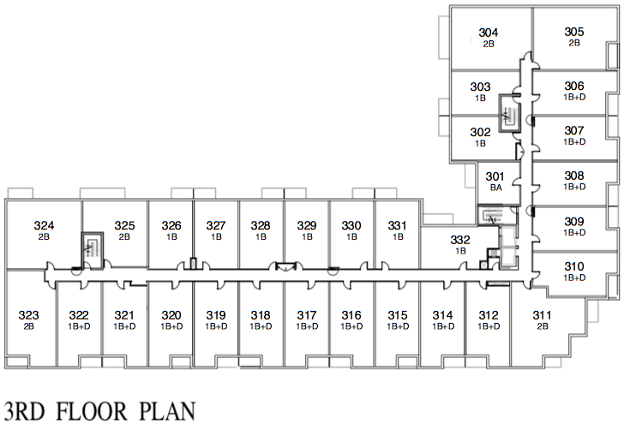

Slide 21
REALLY WELL CONNECTED

Slide 22
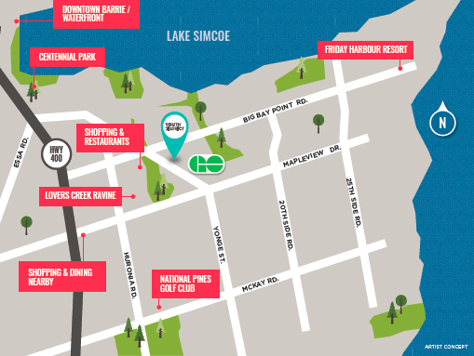

Slide 26
BARRIE AT A GLANCE

Slide 27
AVG. HH INCOME $81,468 (2016 CENSUS)
POPULATON 197,059 (2016 CENSUS)
AVG. HH SIZE 2.56 PEOPLE (2016 CENSUS)
TOTAL HOMES 72, 535 (2016 CENSUS)
4th SAFEST CITY CANADA (CFIB, 2016-MAJOR CITIES)
4 SEASONS RECEREATIONAL COMMUNITY

Slide 28
CITY OF BARRIE-NEXT HOT SPOT

Slide 29
WHY INVEST IN SOUTH BARRIE
LOCATION: Located in the southern part of Barrie easily accessible by highway, 15 minutes to Innisifil, 45 minutes to Vaughan, 3 minutes to GO Barrie South, 12 minutes to Friday Harbour, amenities within walking distance, schools & parks near by & intensification on Yonge St.
PRICE & Value: Compared to prices in Toronto, South District Condos will be better priced and a better value.
CONNECTIVITY: GO Barrie, Hwy 400, Downtown Barrie, Lake Simcoe, Friday Harbor, Cottage Country & Toronto
RENTABILITY: Barrie ranked #4 in Canada for 1 Bedroom Rent with the population set to go in the coming years the location & the supply will make South District sought after by renters.

Slide 30
EMPLOYMNET SECTORS IN BARRIE
HEALTH CARE
ENTERTAINMENT
RECREATION
GOVERNMENT
EDUCATION
MANUFACTURING
RETAIL
FINANCING

Slide 31
ACTIVE CONDO PROJECTS IN BARRIE

Slide 32
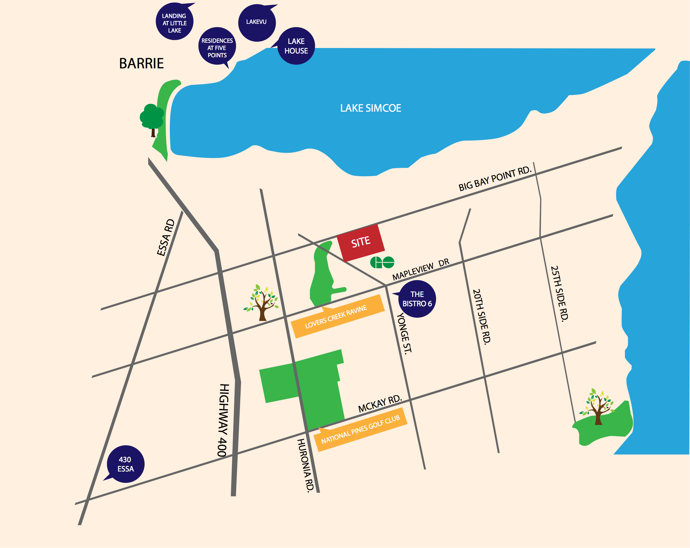

Slide 33
ACTIVE CONDO PROJECTS IN BARRIE
430 ESSA AVG. $520/SQ.FT.
BISTRO 6 FENNEL 2 AVG. $475/SQ.FT.
BISTRO 6 CHILLI 1 AVG. $505/SQ.FT
RESIDENCES AT 5 POINTS AVG. $630/SQ.FT.
LAKEHOUSE AVG. $860/SQ.FT
LAKEVU AVG. $535/SQ.FT.
LANDING AT LITTLE LAKE AVG. $520/SQ.FT.
SOUTH DISTRICT AVG. $508.SQ.FT (does not include Penthouse Collection)

Slide 34
BARRIE RENTAL MARKET

Slide 35
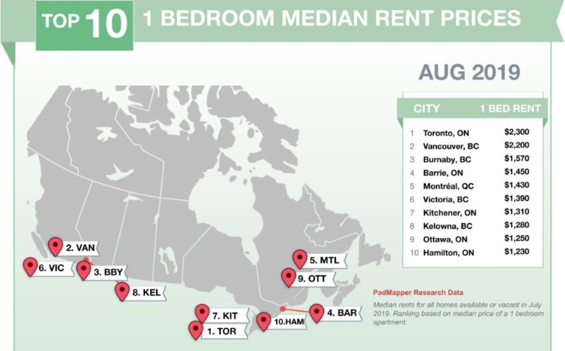
BARRIE #4 IN CANADA FOR 1 BEDROOM RENT IN AUGUST 2019

Slide 36
BARRIE AVG. MONTHLY RENTAL RATE
1 BEDROOM AVG. $1,500/MONTH
2 BEDROOM AVG. $1700/MONTH
2 BEDROOM + DEN AVG. $1900/MONTH
3 BEDROOM AVG. $2100/MONTH
*Based on TREB Stats from January 2019 to September 2019

Slide 37
CONDO RESALE VALUES

Slide 38
BARRIE RESALE STATS AUGST 11 TO SEPTEMBER 8, 2019

